Slide 1
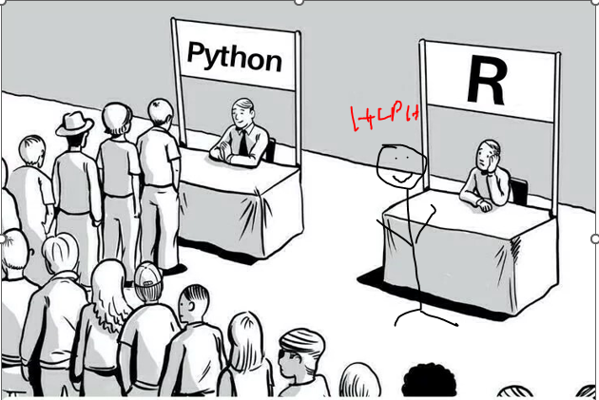

RI R Learning Sessions
By: RI Team Date: TBD

Slide 2
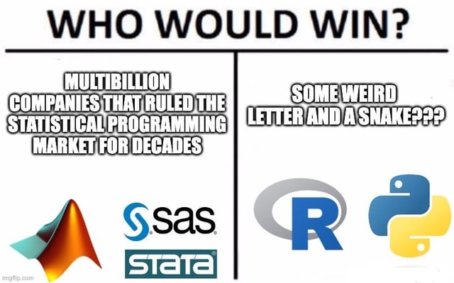
Learning Session General Info
Occur every other week, subjected to change
45 mins total
30 min tutorial
15 mins for questions
Will be recorded
Weeks at a glance [subjected to change]-
Session 1: intro to R, import, and clean
Session 2: intro to R again, longer session
Session 3: more cleaning, column calculation/manipulations
Session 4: functions 0.o
Session 5: datetime
Session 6: wrapping up
Session X: More session base on audience request

Slide 3
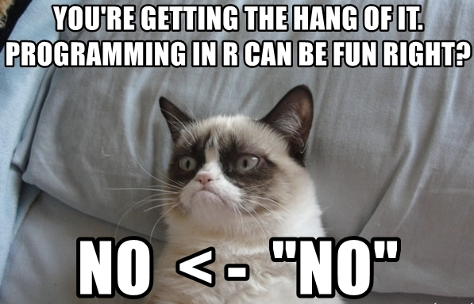
Session 1: intro to R, import, and clean
Learning session inspired from these books: https://epirhandbook.com/new_pages/cleaning.html & https://r4ds.hadley.nz/data-transform
Library that we will use (toolset analogy)
Tidyverse (library are toolsets, functions within are tools)
Janitor
Time to clean, (instruct with R example)
Learn how to read documentation for x library/x function! Documentation are like instruction manuals.

Slide 4
Session 2: Intro to R two hr training
No slide was created, pls refer to recording in sharepoint or referred books.

Slide 5
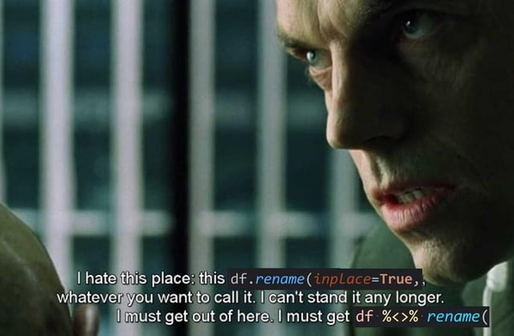
Session 3: more cleaning, column calculation/manipulation
Library that we will use
Tidyverse
insight
Time to clean, (instruct with R example)
Will go over case_when(), mutate, rowMeans, if statement
Will also review object for x function per documentation
If statement will be use for QA

Slide 6
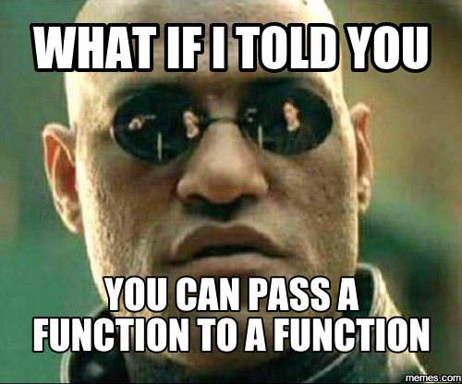
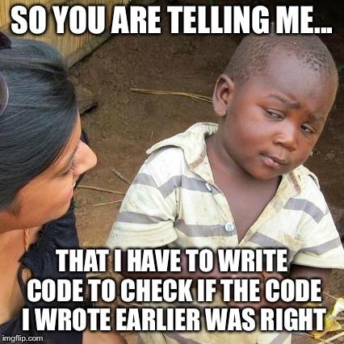
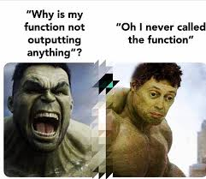
Session 4: Functions 0.o
Library that we will use
Tidyverse
Read up on: https://r4ds.hadley.nz/functions
Functions help with repetitive task. They are like blueprints for code logic.
Ex: u need x values for y report every quarter so you use a function to minimize code repeats.
Make sure you qa your function for unexpected results
Also, not everything needs to be written in a function, sometimes its best to get the output then work on the function later if needed.

Slide 7
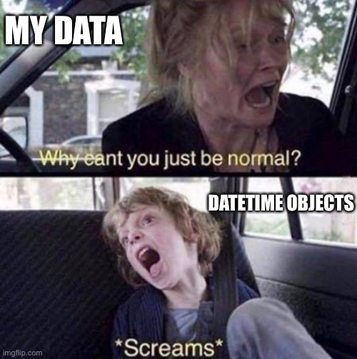
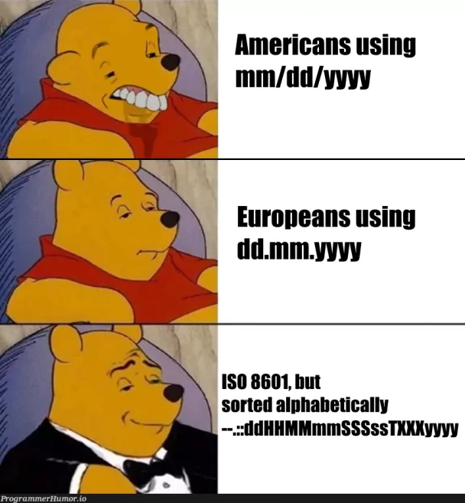
Session 5: Datetime….
Library: lubridate
Read up on: https://r4ds.hadley.nz/datetimes
I will demonstrate how to convert char to datetime..
This is just a simple intro into datetime.. so I recommend diving into R documentation when you are working with it more
TLDR: datetimes are objects that define time:
Ex: month, time of day, time zone, date, etc.
Datetimes are unique because time is can get very complex due to timezone, leap year, earth rotation around sun, time expansion, blah blah lol

Slide 8
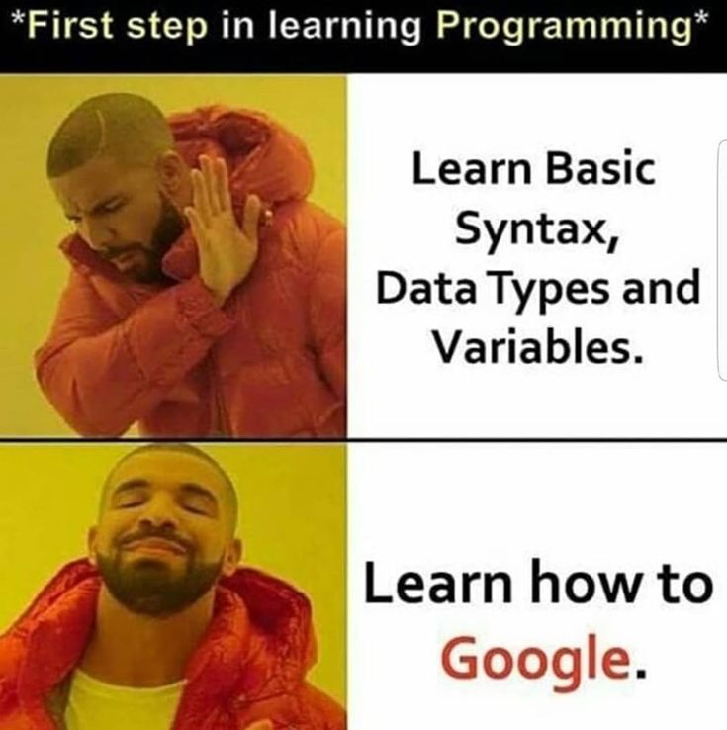
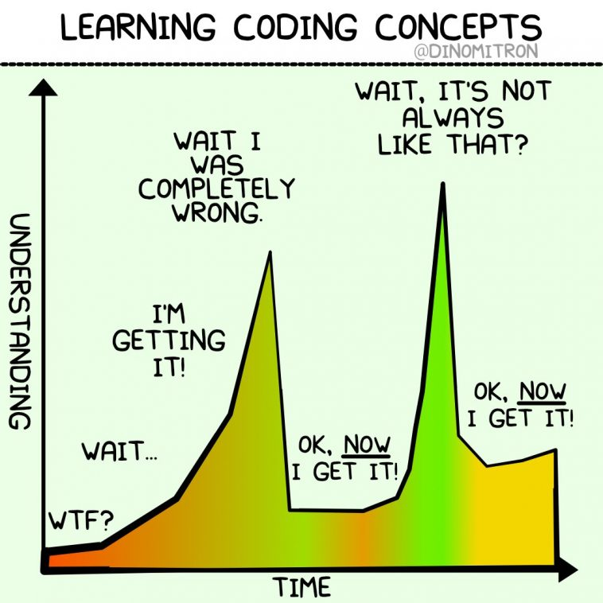
Session 6: Wrapping up
Will go over everything we did in the sessions.
Will briefly go over git for version control before we go over the other sessions
Will create another survey to see what we want to go over now.

Slide 9
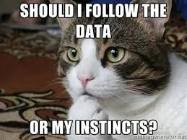
Session 8: Modeling
Go over linear regression
Review some lecture recordings:
https://mediaspace.gatech.edu/playlist/details/1_g11t1e5t (linear regression)
Lecture 1 (IntroRegression): https://mediaspace.gatech.edu/media/OMSA_ISyE6501_M8L1_IntroRegression_refresh/1_efuxlc3o
Lecture 2 (UsingRegression): https://mediaspace.gatech.edu/media/OMSA_ISyE6501_M8L3_UsingRegression_refresh_ver2/1_zapjhxsd
https://mediaspace.gatech.edu/playlist/details/1_5e31tm21 (training)
https://mediaspace.gatech.edu/media/OMSA_ISyE6501_M3L1_IntrotoValidation_refresh/1_cjcexfu3
Go over hw and solution
Ideas for the future (descriptive, predictive, and prescriptive)
other models (svm, knn, kmeans, random forest (lm/logit for hella scenarios; car insurance diff based on age, type of car, geography, history, credit score))
Tuning; elastic net, ridge, lasso, aic, pca, etc.

Slide 10
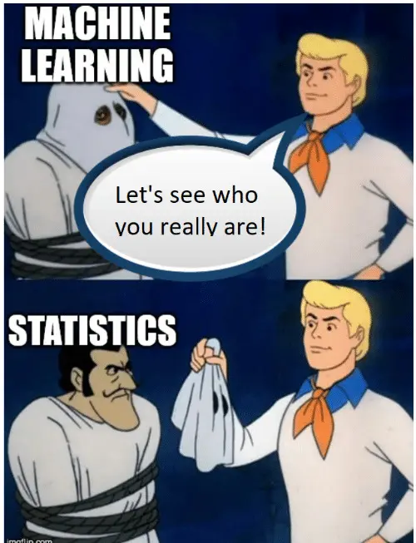
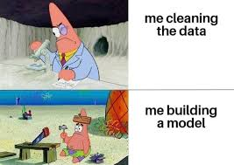
Session 8: Modeling
Go over linear regression
Review some lecture recordings:
https://mediaspace.gatech.edu/playlist/details/1_g11t1e5t (linear regression)
Lecture 1 (IntroRegression): https://mediaspace.gatech.edu/media/OMSA_ISyE6501_M8L1_IntroRegression_refresh/1_efuxlc3o
Lecture 2 (UsingRegression): https://mediaspace.gatech.edu/media/OMSA_ISyE6501_M8L3_UsingRegression_refresh_ver2/1_zapjhxsd
https://mediaspace.gatech.edu/playlist/details/1_5e31tm21 (training)
https://mediaspace.gatech.edu/media/OMSA_ISyE6501_M3L1_IntrotoValidation_refresh/1_cjcexfu3
Go over hw and solution
Ideas for the future (descriptive, predictive, and prescriptive)
other models (svm, knn, kmeans, random forest (lm/logit for hella scenarios; car insurance diff based on age, type of car, geography, history, credit score))
Tuning; elastic net, ridge, lasso, aic, pca, etc.

